Slide 1
Building Microsoft Graph applications
Build a mobile application with Xamarin using Microsoft Graph

Slide 2

Build a mobile application with Xamarin using Microsoft Graph
Application registration
NuGet Packages
Application experience
Overview of the sample

Slide 3
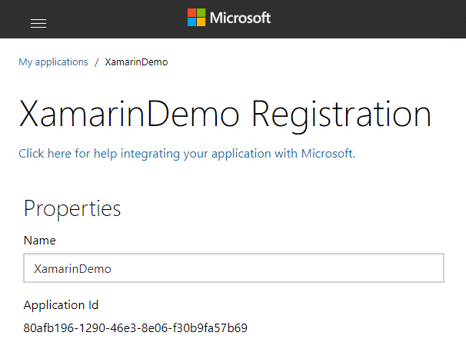
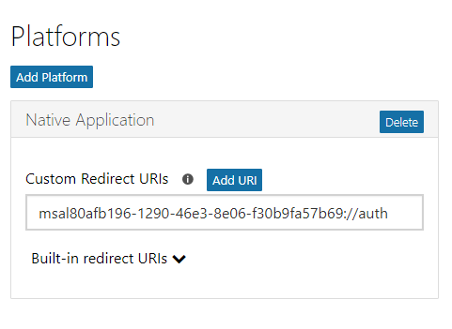
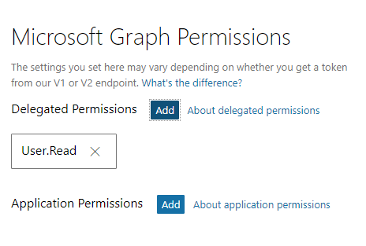
Application registration
Create a new application
Create a new application in the Application Registration Portal. A unique identifier is created for your app.
Add a Native Application platform
Add a Native Application platform to your application registration.
Add permissions
Add permissions that your application will need.
Notes:
Add a Native Application platform and copy the redirect URI for the application.
Grant permissions that your app will require.

Slide 4

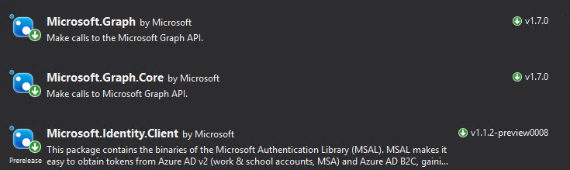
NuGet packages
Notes:
Add the Microsoft.Identity.Client package to all projects, and add the Newtonsoft.Json package to the PCL project.
Install-Package Microsoft.Identity.Client -ProjectName XamarinApp -pre
Install-Package Newtonsoft.Json -ProjectName XamarinApp -pre
Install-Package Microsoft.Identity.Client -ProjectName XamarinApp.Android -pre
Install-Package Microsoft.Identity.Client -ProjectName XamarinApp.iOS -pre
Install-Package Microsoft.Identity.Client -ProjectName XamarinApp.UWP -pre
Install-Package Microsoft.Identity.Client -ProjectName XamarinApp -pre
The Microsoft.Identity.Client package is pre-release, make sure to include pre-release packages either using the checkbox in the GUI or including the –pre switch on the command line.

Slide 5
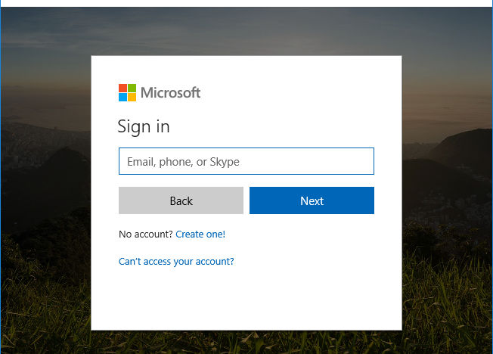
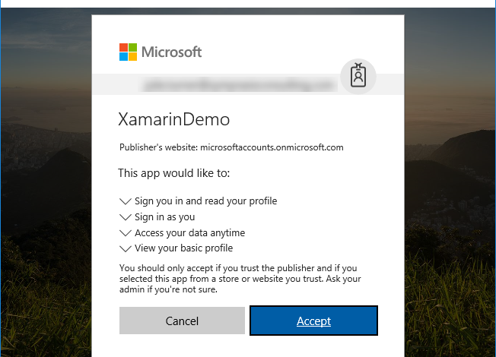
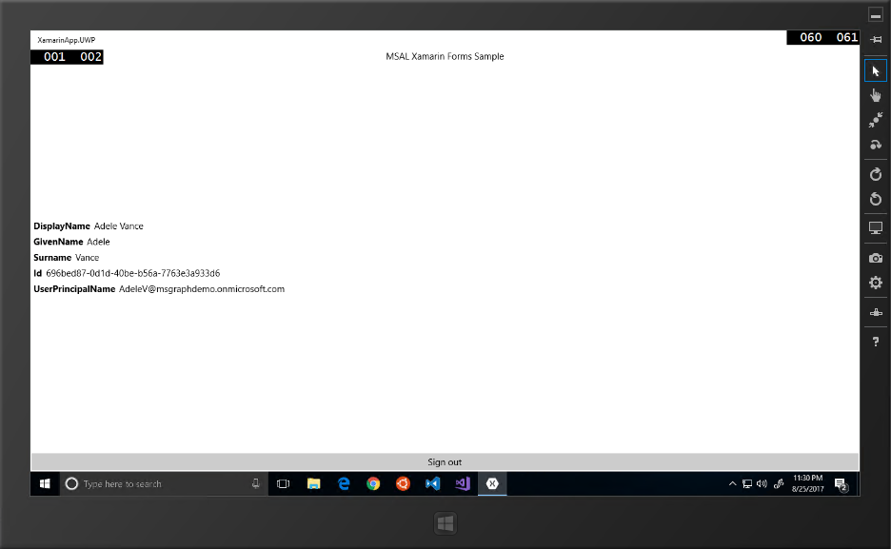
Application experience
User prompted to sign in
The user is prompted to sign in.
Prompt for consent
The user is prompted to grant consent to the application.
Data is securely returned
The Microsoft Graph API is queried and data is securely returned to the client.

Slide 6

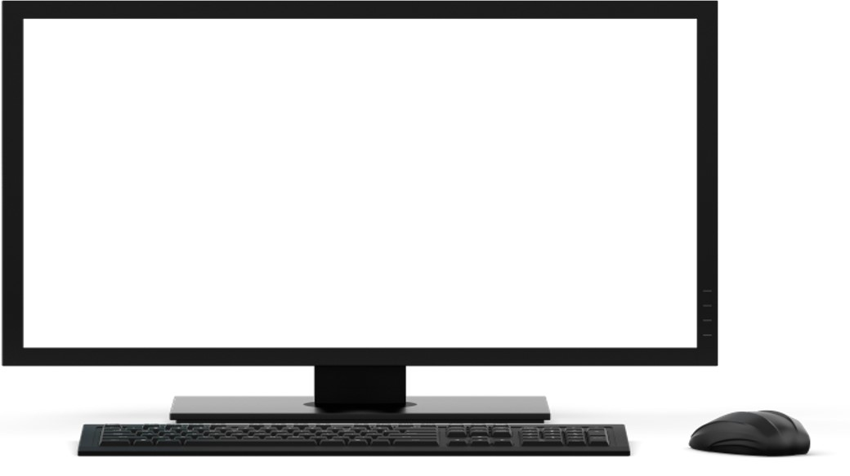
Overview of the sample
Get token
Access token
Teams
Groups
Tasks
Chats
Calendar
Files
Get current user’s profile
Microsoft Graph
Insights
My profile
Messages
Coworkers
User
Meetings
Devices
People

Slide 7
Mobile and native applications – authorization code grant and v2 endpoint
https://login.microsoftonline.com/common
Application
/common/OAuth/v2.0/authorize
/common/OAuth/v2.0/token
https://graph.microsoft.com
?response_type=code&client_id=…
Sign in, consent
authorization code
?grant_type=authorization_code&code=…
access_token, refresh_token, id_token
/v1.0/me (access token)
Current user’s profile
Token expires
?grant_type=refresh_token&refresh_token=…
access_token, refresh_token, id_token
/v1.0/me (access token)
Current user’s profile
Notes:
The call to /common/OAuth/v2.0/authorize will pop up a login screen and request permissions consent.
It is important to cache the refresh token to request a new access token.

Slide 8
Demo

Slide 9
Scenarios where this is useful
Teams
Groups
1
Mobile applications on multiple platforms that require access to data.
Monitoring applications to ensure consistent operations.
Master-detail applications that can perform CRUD operations against Graph data
Tasks
2
Chats
Calendar
Files
3
Insights
Microsoft Graph
Messages
And many more…
Coworkers
User
Meetings
People
Devices
Notes:
While this section refers to a very simple scenario, it’s not hard to imagine the new capabilities that you could add to an existing application or new scenarios. Using just JavaScript, you could build an application that gathers intelligence on individuals invited to a meeting such as the files they are working on, the groups they belong to, and people that are common to each of you.

Slide 10
Thank you.

